Slide 1

FGRE Wireless tutorial

Slide 2
FGRE Wireless Tutorial
Part 1 :
  WiFi experiment @ iMinds w-iLab.t
  Including mobile nodes
  Throughput tests
Part 2 :
  WiMAX tutorial @ UTH Nitos
  Channel quality measurements

Slide 3
Part 1: WiFi @ w-iLab.t

Slide 4
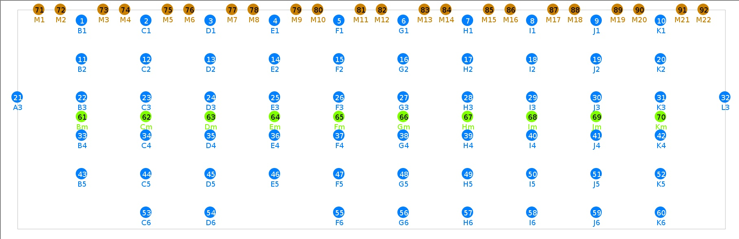
w-iLab.t Zwijnaarde

Slide 5
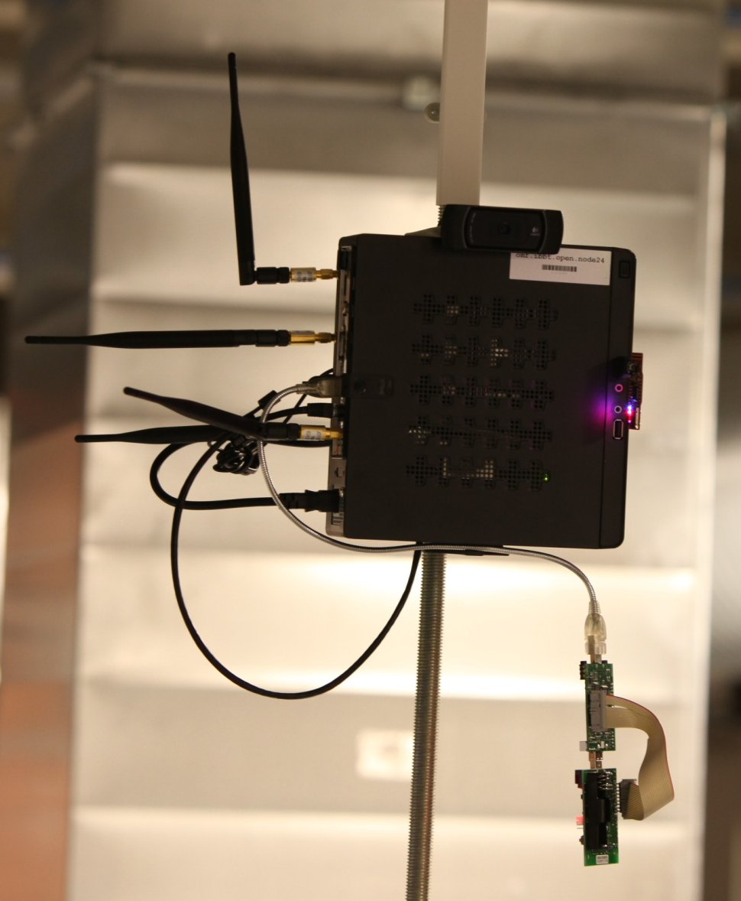
Hardware
Embedded PC (Zotac)
  2x WiFi 802.11 a/b/g/n
  802.15.4 sensor node
  Bluetooth 3.0 EDR

Slide 6


Slide 7
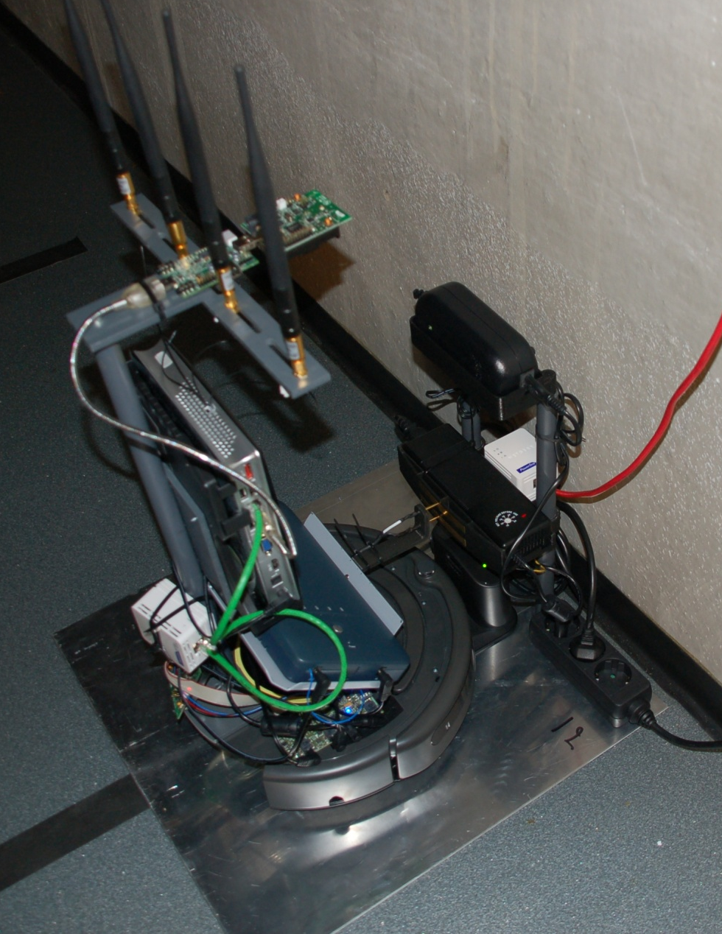
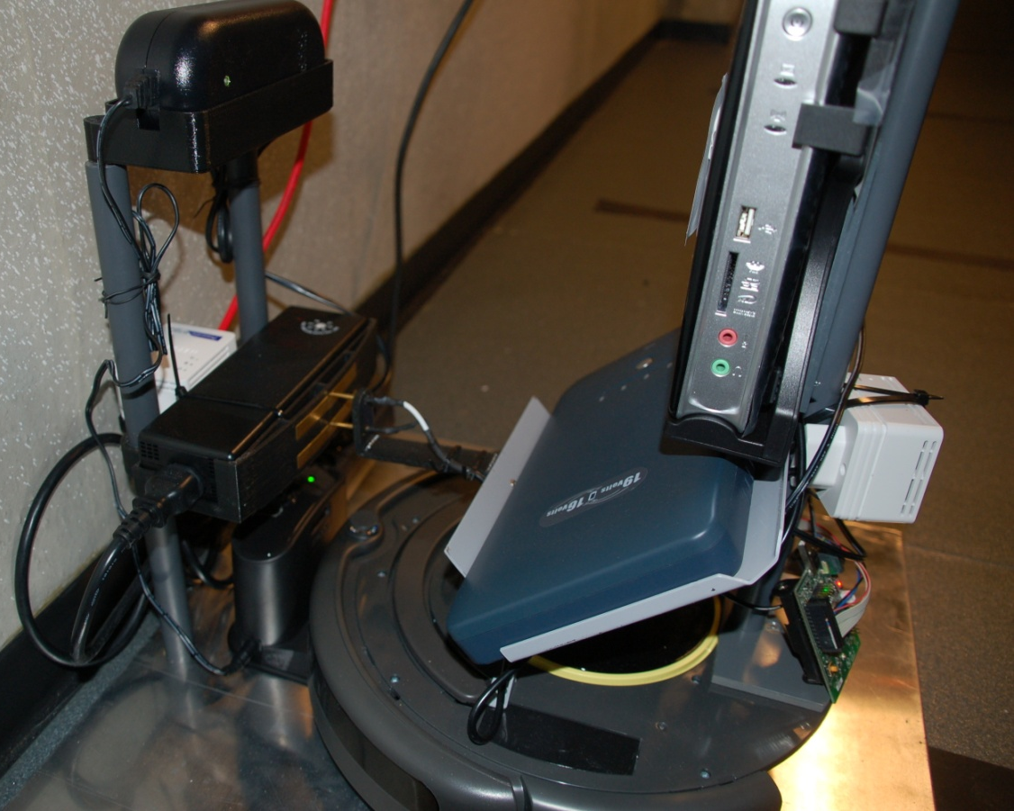
Mobile nodes

Slide 8
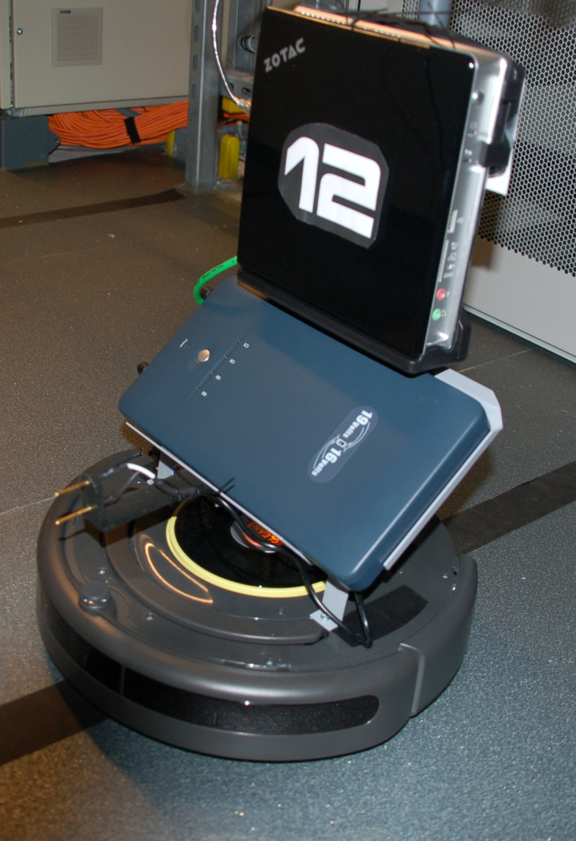
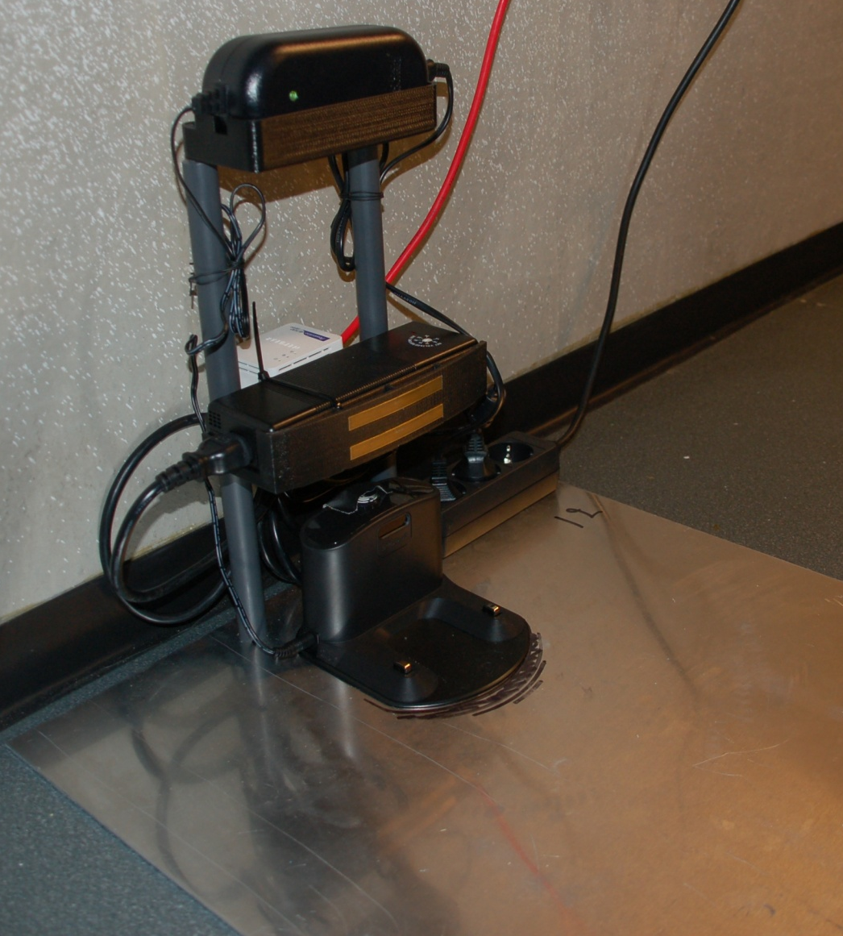

Slide 9
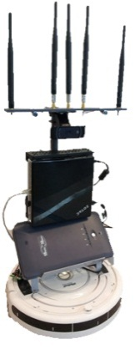
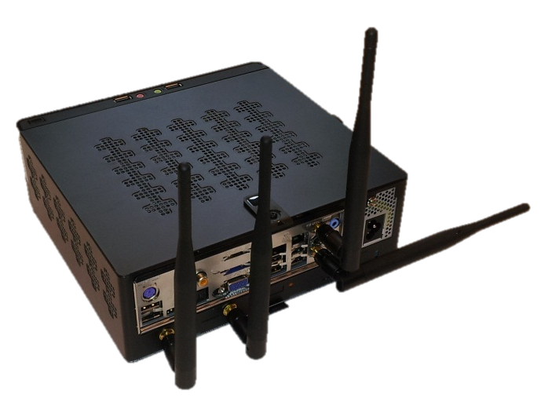
Tutorial
Access point
Client
iPerf client
iPerf server

Slide 10
Step-by-step
http://doc.ilabt.iminds.be/fgre/tutorials.html
Swap in 3 nodes with jFed
  Choose Wireless nodes
  Choose specific node
  2 fixed / 1 mobile (see table)
Set up wireless AP on robot
  nano hostapd.conf ( see table )
  hostapd hostapd.conf &
  ifconfig wlan0 192.168.X.1/24 up (X = group number)
Connect to AP from fixed node
  iwconfig wlan0 mode managed; iwconfig wlan0 essid groupX
  ifconfig wlan0 192.168.X.10/24 up

Slide 11
Step-by-step (2)
Start iperf server on AP (robot)
  iperf –s –u –i 1
Start iperf client on fixed node
  iperf –u –c 192.168.X.1 –b 40M –i 1 –t 60000 &
Check if everything is working OK
http://am.wilab2.ilabt.iminds.be:4000/index_ipv6.html
Undock the robot ( no SSH anymore)
Drive around and see the impact on throughput
If you lose the connection -> Dock again

Slide 12
6 Groups (2 or 3 persons/group)
Account | Channel | Mode | client | ap | backup
demo2 | 1 | g | zotacD3 | mobile2 | zotacB3
demo4 | 6 | g | zotacC2 | mobile4 | zotacC3
demo5 | 11 | g | zotacD1 | mobile5 | zotacD2
demo7 | 36 | a | zotacE1 | mobile7 | zotacF2
demo10 | 40 | a | zotacF1 | mobile10 | zotacG2
demo13 | 44 | a | zotacH2 | mobile13 | zotacH3

