Slide 1
LabWiki The Complete Experiment Lifecycle in a Tool
Divya Bhat, Mike Zink, Max Ott, Thierry Rakotoarivelo FGRE 2015,
July 07th, 2015

Slide 2
Experiment Workflow

Slide 3
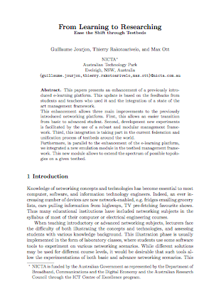
The “Experiment Cycle”
Design
Notes
Experiment Description
Setup
Code
Runs
Measurements
Execute

Slide 4
The “Successful Experiment Cycle”
Publish
Design
Notes
Experiment Description
Setup
Code
Runs
Measurements
Execute

Slide 5
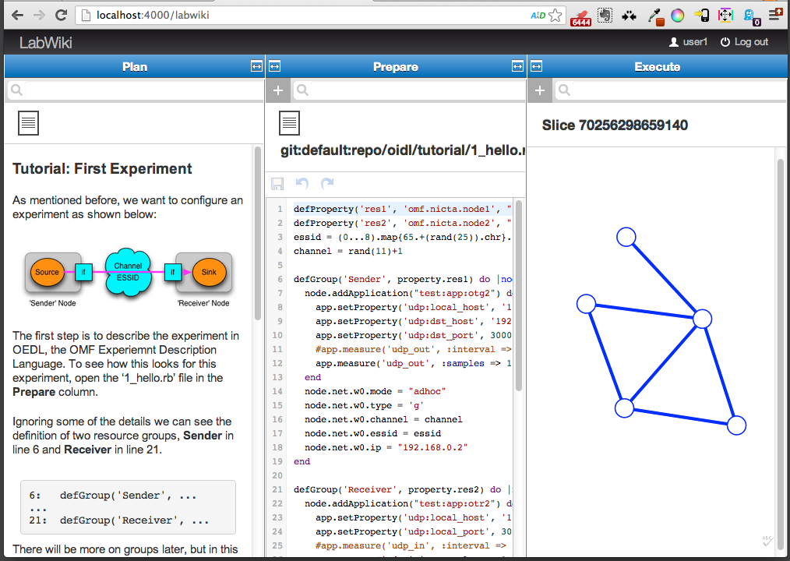
“Experiment Cycle” in a Tool: LabWiki

Slide 6
Search
Wiki
Edit
Run

Slide 7
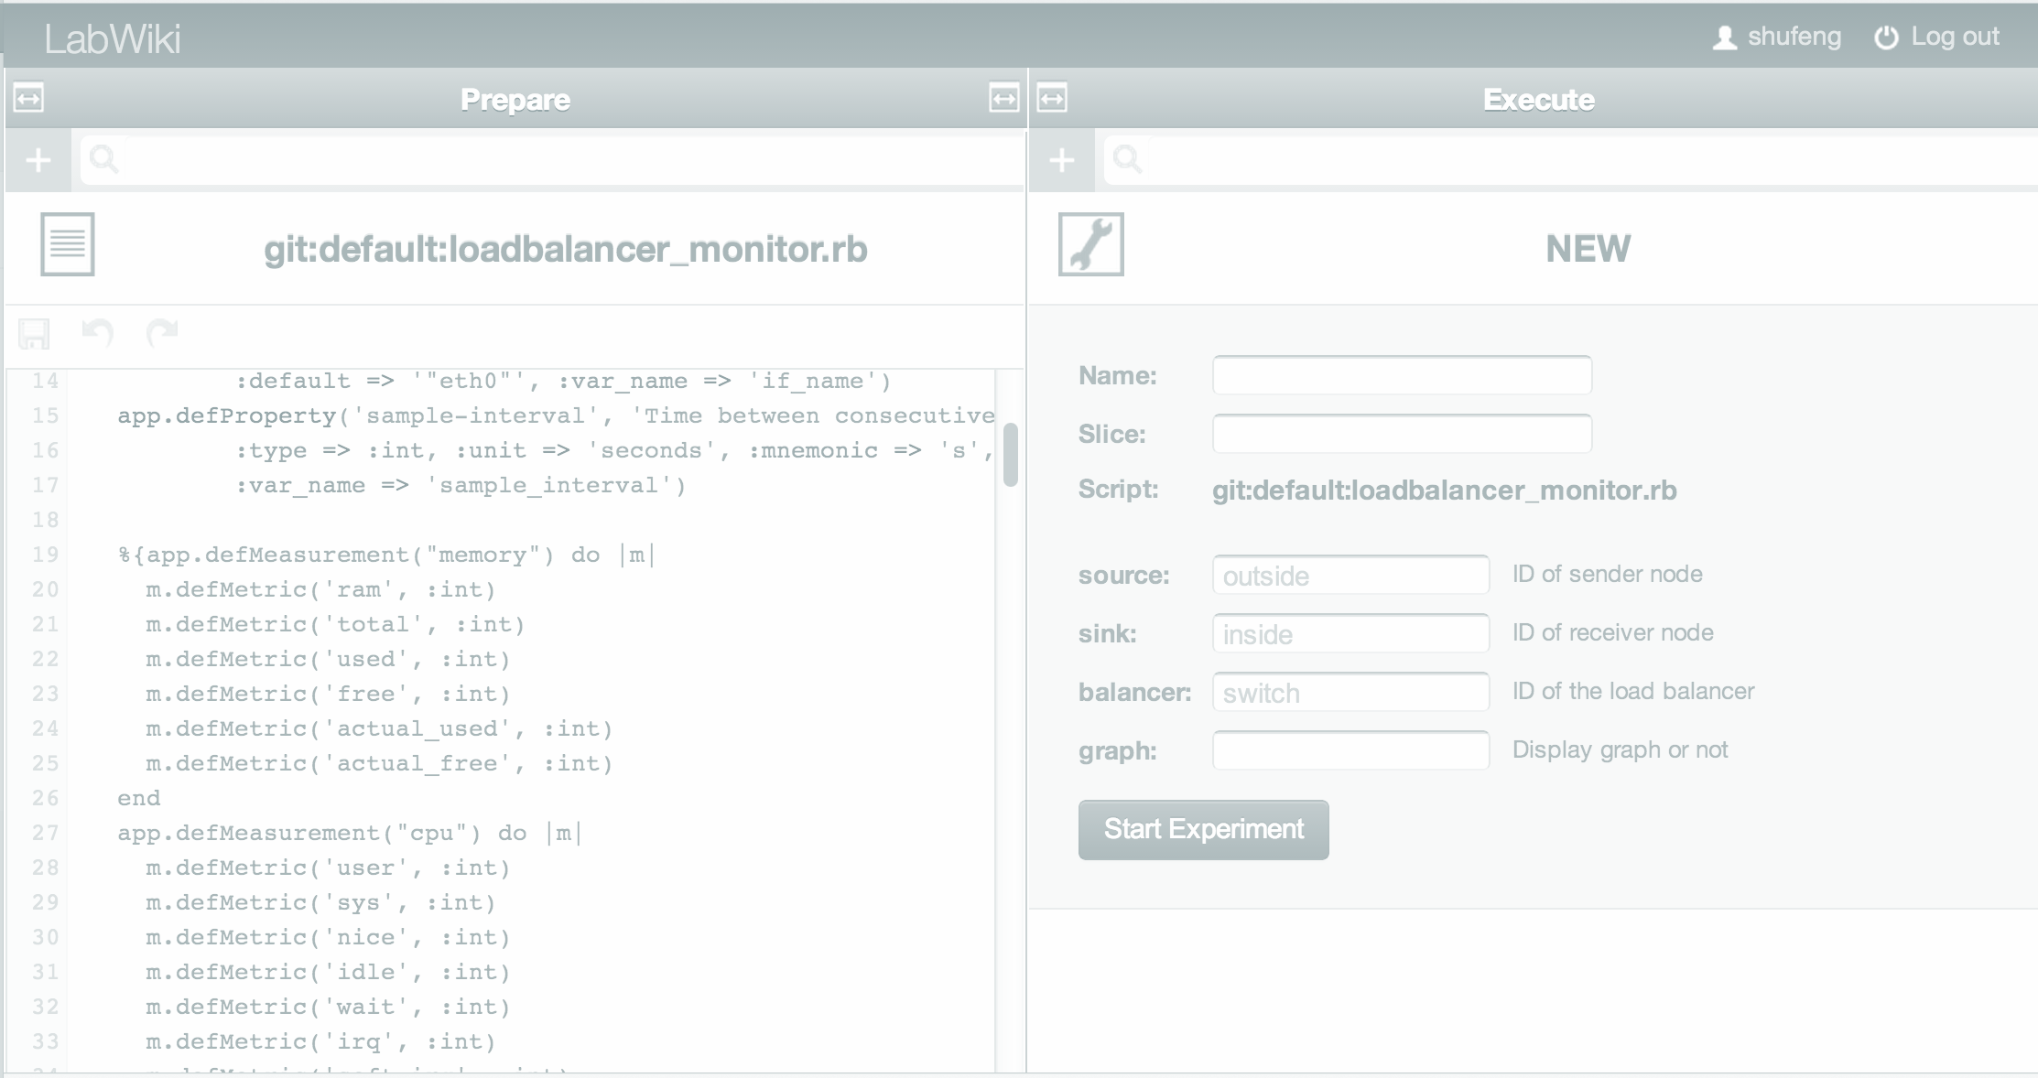
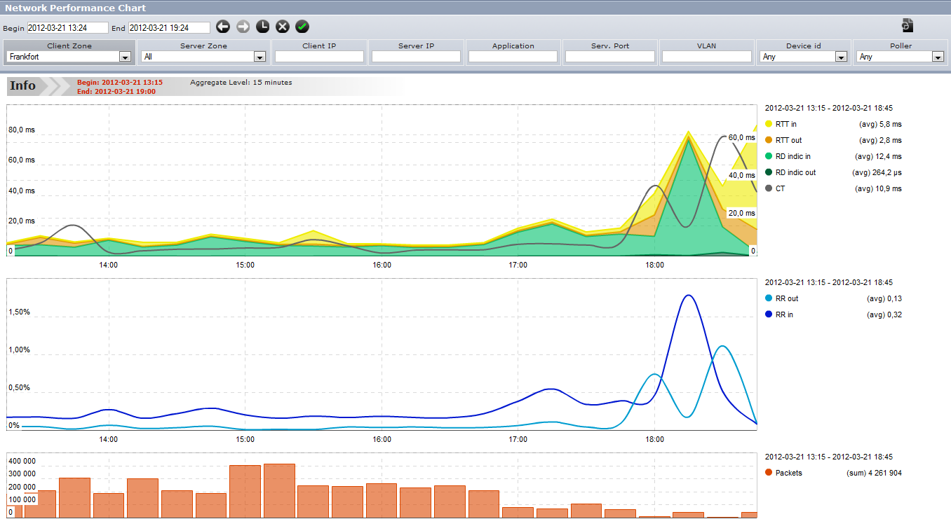
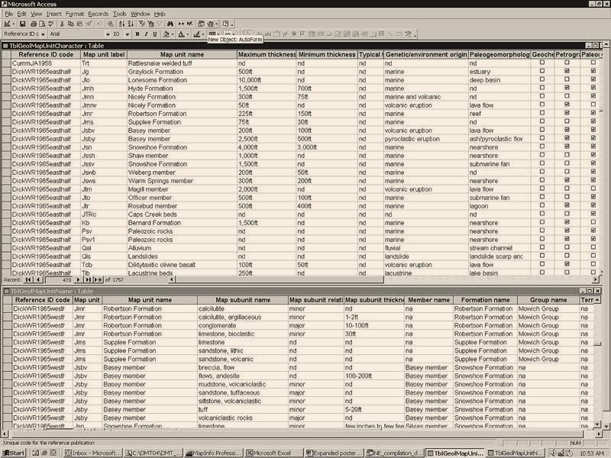
Collect and Archive
Experimenter
iRODS
Automated
6.Obtain
5.Save
OEDL
5.Save
1.Instrument
LabWiki
OMF
4.Plot
4.Plot
OML
Server
0.Reserve
2.Run
2.Run
3.Collect
3.Collect
GENI
TestBed
OML Client

Slide 8
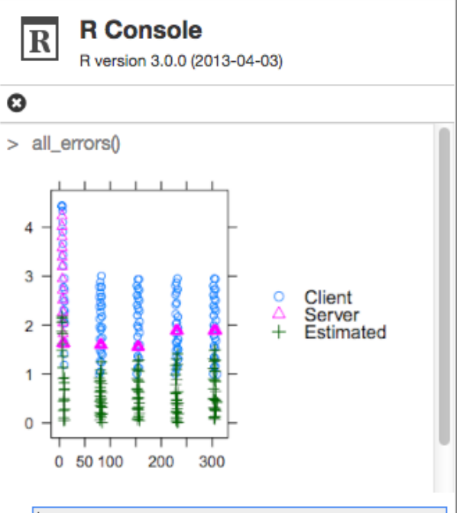
For Experimenters
Repeatable
one-time OEDL
common network measurements
custom defined measurements
Lab Notes
Use Wiki for technical report
Results
R scripts for graph

Slide 9
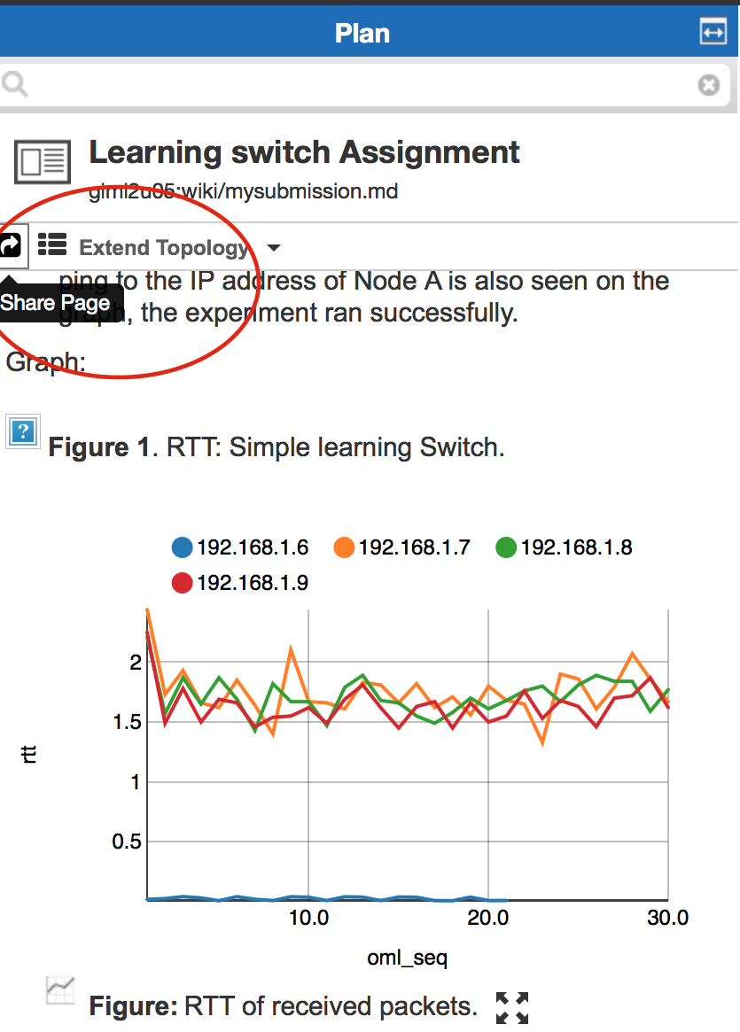
For Students
Prepared experiment script (OEDL)
Read-only
Create copy or run as is
Assignment
Execute experiment
Generate results
Write comments
Submit

Slide 10
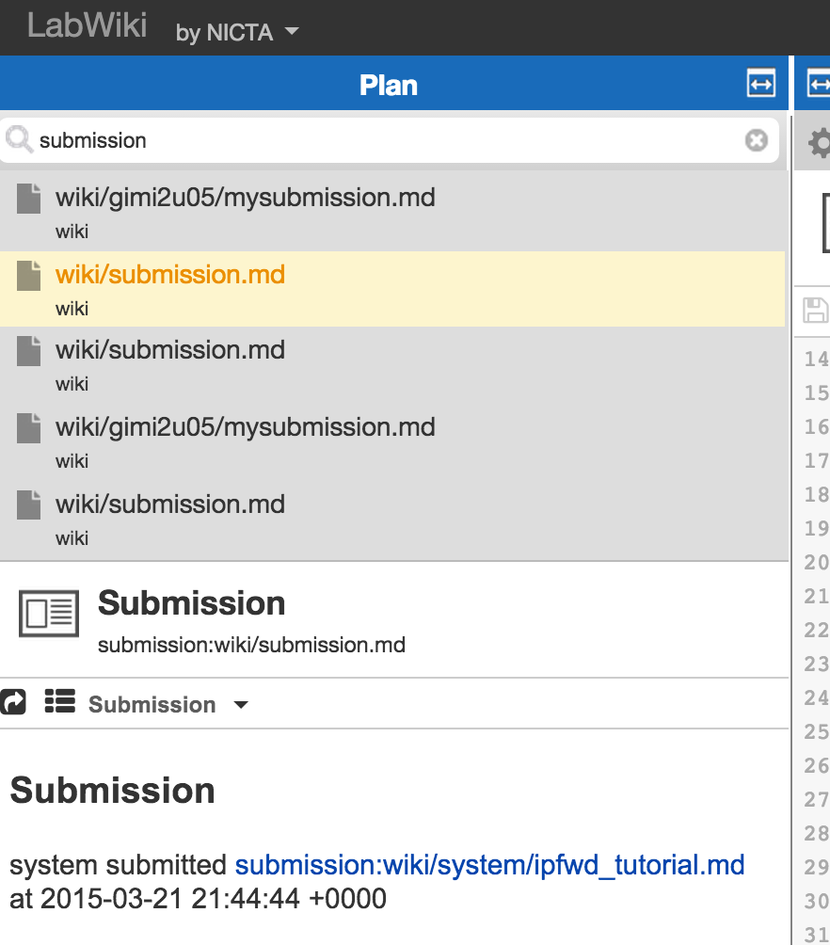
For Educators
Create Experiment Script (OEDL)
Unlimited update
Create instructions (Wiki)

Slide 11
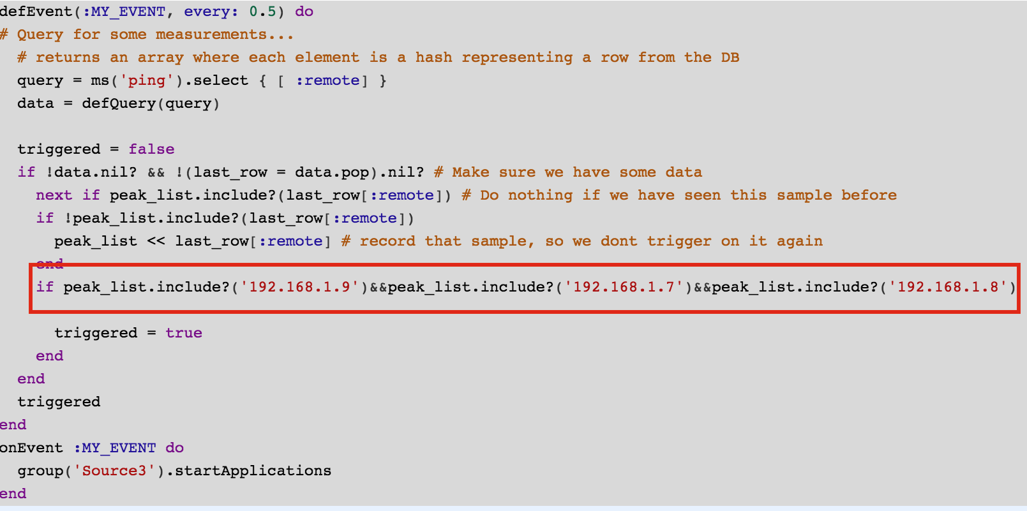
For Educators
Auto checking
Custom event trigger
View submissions

Slide 12
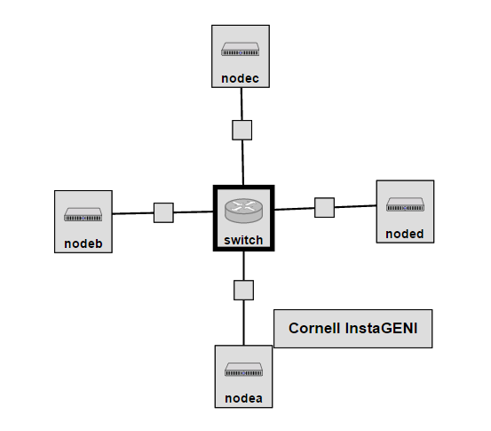
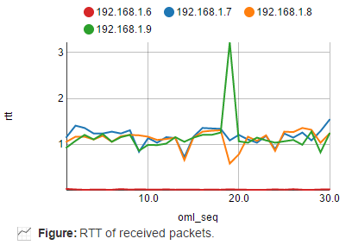
Assignment I – Learning Switch
Teaches the basics of learning switch functionality used by Ethernet switches
Learning switch implementation through Trema controller
OEDL script to plot graph
Lessons learned: learning switch functionality, using different metrics to plot graphs through labWiki

Slide 13
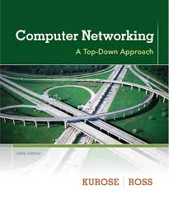
Learning Switch
Source: A
Dest: A’
A
A A’
frame destination unknown:
flood
C’
B
destination A location known:
6
1
2
A A’
A A’
A A’
A A’
A A’
selective send
5
4
3
More info in chapter 5 of “Computer Networks”, Kurose & Ross
B’
C
A’ A
A’
MAC addr interface TTL
A
1
60
Switch table
(initially empty)
A’
4
60

Slide 14
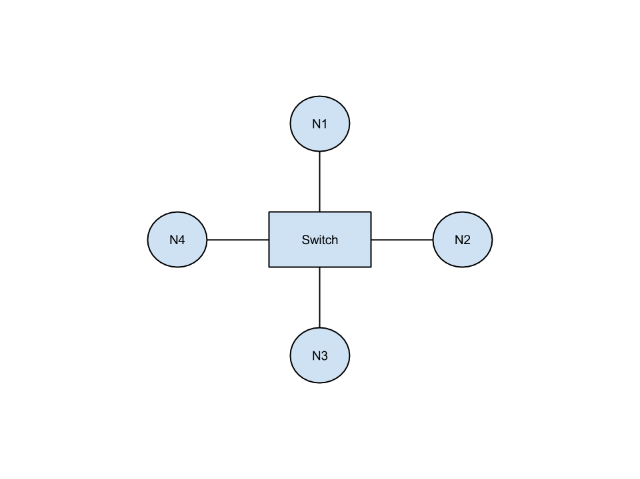
Assignment Topology
N1 – N4: regular end systems
Switch: VM with OVS installed ➔ sw-based OF switch
Trema-based OF controller running on Switch https://github.com/trema/trema
Goal: Implement learning switch and verify its correct behavior

Slide 15
DEMO

Slide 16
Architecture
Node1
Persistent Server
Your Slice
RC
ML
OML Server
Node3
Switch
Node2
Job Service
RC
ML
RC
ML
RC
ML
EC
Node3
AMQP Server
RC
ML
iRODS
LabWiki

Slide 17
AMQP Messaging
Node1
Node2
RC
ML
RC
ML
Persistent Server
emmy9
Switch
OML Server
RC
ML
Job Service
EC
AMQP Server
LabWiki Images with tools available for InstaGENI and ExoGENI
iRODS
LabWiki

Slide 18
EC/RC Messaging
Node1
Node2
RC
ML
RC
ML
Persistent Server
emmy9
Switch
OML Server
RC
ML
Job Service
EC
AMQP Server
iRODS
LabWiki

Slide 19
Data Collection
Persistent Server
Node1
Node2
RC
ML
RC
ML
OML Server
Job Service
Node3
EC
RC
ML
AMQP Server
iRODS
LabWiki

Slide 20
LabWiki
Persistent Server
Node1
Node2
RC
ML
RC
ML
OML Server
Job Service
Switch
EC
RC
ML
AMQP Server
iRODS
LabWiki

Slide 21
Documentation
OML: http://oml.mytestbed.net/projects/oml
Job Service: https://github.com/mytestbed/omf_job_service
OMF: http://oml.mytestbed.net/projects/omf
AMQP: http://www.rabbitmq.com/
iRODS: http://irods.org/
LabWiki: https://github.com/mytestbed/labwiki

Slide 22
Orchestrating an experiment in LabWiki

Slide 23
Steps
Reserve slice with VMs that boot GIMI image
Verify that slice is up
Define experiment to be executed in LabWiki
Run and observe experiment
Archive results
Document results
Delete slice (be a good GENI citizen by sharing!!)

Slide 24
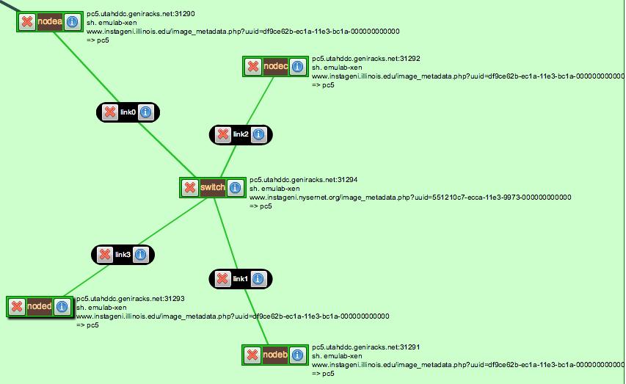
Nodes 1-4
Image
Postboot script
ssh into node

Slide 25
Nodes 1-4: Image
ExoGENI
Debian 6
OMF
OML client & apps
URL to image: http://emmy9.casa.umass.edu/Disk_Images/ExoGENI/deb6ovsgimiv4.xml
InstaGENI
Ubuntu 12.04
OMF
OML client & apps
URL to image: https://www.instageni.illinois.edu/image_metadata.php?uuid=df9ce62b-ec1a-11e3-bc1a-000000000000

Slide 26
Nodes 1-4: Postboot Script
Postboot script (http://emmy9.casa.umass.edu/GEC-20/gimidev.tar.gz)
#!/bin/bash
read -r slice1 </var/emulab/boot/nickname
slicename=$(echo $slice1 | cut -f2 -d.)
host1=$(hostname)
host=$(echo $host1 | cut -f1 -d.)
slice=`ruby -e "print '$slicename'[/[^+]*$/]"`
echo $host > /etc/hostname
/bin/hostname -F /etc/hostname
echo "---
:uid: $host-$slice
:uri: amqp://gimi3.casa.umass.edu
:environment: production
:debug: false" > /etc/omf_rc/config.yml
if grep 'Ubuntu' /etc/issue; then
restart omf_rc
else
/etc/init.d/omf_rc restart
fi
Initiates connect to AMQP server

Slide 27
Nodes 1-4: Postboot Script
Postboot script (http://emmy9.casa.umass.edu/GEC-20/gimidev.tar.gz)
Install Scripts
wget http://emmy9.casa.umass.edu/GEC-20/fdb.rb -P /root/
wget http://emmy9.casa.umass.edu/GEC-20/Insta_post/learning-switch_copy.rb -P /root
chmod +x /root/learning-switch_copy.rb
wget http://emmy9.casa.umass.edu/GEC-20/Insta_post/learn_ofcollect.rb -P /usr/local/bin
chmod +x /usr/local/bin/learn_ofcollect.rb
wget http://emmy9.casa.umass.edu/GEC-20/Insta_post/ovs-setup2.sh -P /root
chmod +x /root/ovs-setup2.sh

Slide 28
Switch
Image
Postboot script
ssh into node

Slide 29
Switch: Image
ExoGENI
Debian 6
OMF
OML
OVS
URL to image: http://emmy9.casa.umass.edu/Disk_Images/ExoGENI/deb6ovsgimiv4.xml
InstaGENI
Ubuntu 12.04
OMF
OML
OVS
URL to image: https://www.instageni.nysernet.org/image_metadata.php?uuid=551210c7-ecca-11e3-9973-000000000000

Slide 30
Switch: Postboot Script
Rspec: <execute command="wget http://emmy9.casa.umass.edu/GEC-20/fdb.rb -P /root/; wget http://emmy9.casa.umass.edu/GEC-20/learning-switch.rb -P /root/; sh /gimidev/gimibot.sh $self.Name() $sliceName; wget http://emmy9.casa.umass.edu/GEC-20/ovs-setup.sh -P /root/; sh /root/ovs-setup.sh" shell="sh"/>
ovs-setup.sh:
#!/bin/bash
ethnum=$(ifconfig | grep 'Link encap:' | awk '{print $1}')
while [[ "$ethnum" != *eth1* || "$ethnum" != *eth2* || "$ethnum" != *eth3* || "$ethnum" != *eth4*]]; do
/usr/local/bin/neuca-netconf
sleep 10
ethnum=$(ifconfig | grep 'Link encap:' | awk '{print $1}')
done
ovs-vsctl add-br test
ovs-vsctl add-port test eth1
ovs-vsctl add-port test eth2
ovs-vsctl add-port test eth3
ovs-vsctl add-port test eth4
ovs-vsctl set-controller test tcp:127.0.0.1:6653

Slide 31
Debugging the RC
ssh into node ssh –i ~/.ssh/yourkey management_ip_of_node
On the node: /var/log/omf_rc.log
[2014-06-20 17:48:03 +0000] INFO OmfRc::Runner: Starting OMF Resource Controller version '6.1.2.pre.5'
[2014-06-20 17:48:04 +0000] INFO OmfRc::Runner: Connected using {:proto=>:amqp, :user=>"guest", :domain=>"127.0.0.1"}
[2014-06-20 17:49:05 +0000] WARN OmfCommon::Comm::AMQP::Communicator: Lost connectivity. Trying to reconnect...
[2014-06-20 17:49:05 +0000] INFO OmfRc::Runner: Starting OMF Resource Controller version '6.1.2.pre.5'
[2014-06-20 17:49:05 +0000] INFO OmfRc::Runner: Connected using {:proto=>:amqp, :user=>"guest", :domain=>"127.0.0.1"}
[2014-06-20 17:56:06 +0000] INFO OmfRc::ResourceProxy::AbstractResource: App Event from 'ping_cxt_0' (#0) - STARTED: 'env -i /usr/local/bin/ping-oml2 -a 192.168.1.7 -c 30 --oml-config /tmp/854849b2-19a2-475d-9588-278271d894aa-1403286966.xml'
[2014-06-20 17:56:06 +0000] INFO OmfRc::ResourceProxy::AbstractResource: App Event from 'ping_cxt_1' (#0) - STARTED: 'env -i /usr/local/bin/ping-oml2 -a 192.168.1.8 -c 30 --oml-config /tmp/96c56027-f62e-41b1-873d-ba39fe429ab9-1403286966.xml'
[2014-06-20 17:56:06 +0000] INFO OmfRc::ResourceProxy::AbstractResource: App Event from 'ping_cxt_2' (#0) - STARTED: 'env -i /usr/local/bin/ping-oml2 -a 192.168.1.9 -c 30 --oml-config /tmp/53a86677-61d6-4b31-8f65-4e272d7b2343-1403286966.xml'

Slide 32
Writing Custom-Defined Applications for LabWiki

Slide 33
Writing an OML Application
Example: Instrumenting OpenFlow statistics
def stats_reply (dpid, message)
puts "[flow stats_reply #{@my_switch}]---------------------------------"
byte_count = 0
packet_count = 0
flow_count = 0
throughput = 0
inst_throughput =0
total_flow_count = message.stats.length
if(total_flow_count != 0)
message.stats.each do | flow_msg |
# WARNING: This only works for the EXACT case of two actions. If we add more than two actions the flow monitoring
# will break.
flow_ip = flow_msg.match
puts "This is the message #{flow_ip.nw_src}"
flow_count = flow_count + 1
byte_count += flow_msg.byte_count
packet_count += flow_msg.packet_count
if flow_msg.duration_sec + flow_msg.duration_nsec/1000000000 != 0
throughput += flow_msg.byte_count/(flow_msg.duration_sec + flow_msg.duration_nsec/1000000000)
file = File.open("/tmp/flowstats.out", "a")
file.puts "#{flow_ip.nw_src} #{flow_count.to_s} #{byte_count} #{packet_count} #{throughput} Bps"
file.close
end
end
end
@prev_byte_count = byte_count
end

Slide 34
Writing an OML Application
Example: Instrumenting OpenFlow statistics
- Define measurement points
class MPThroughput < OML4R::MPBase
name :ofthroughput
param :srcaddr, :type => :string
param :numflows, :type => :int64
param :numbytes, :type => :int64
param :numpacket, :type => :int64
param :throughput, :type => :int64
param :units, :type => :string
end

Slide 35
Writing an OML Application
Example: Instrumenting OpenFlow statistics
- Parse measurement fields
def processOutput(output)
column = output.split(" ")
puts "Each line process"
# Inject the measurements into OML
MPThroughput.inject("#{column[0]}", column[1], column[2], column[3], column[4], "#{column[5]}")
end

Slide 36
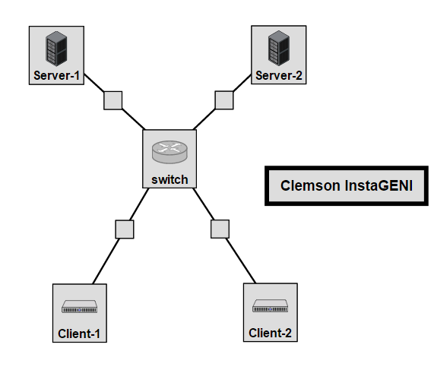
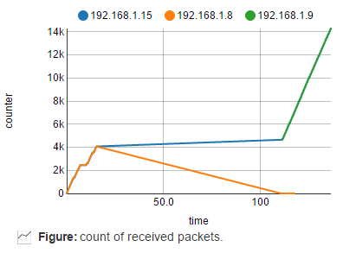
Assignment II - Data-Center Routing
Teaches the basics of load balancing for servers in a data-center
Algorithm can be round robin, throughput-based or random for routing through the OpenFlow switch
Lessons learned: any-casting, how the packet destination is modified for routing, different algorithms for load balancing, data center technology

Slide 37
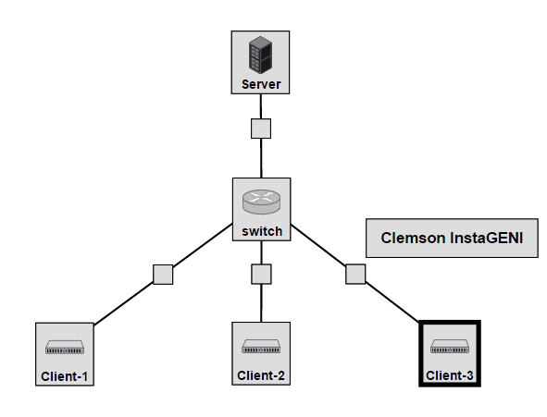
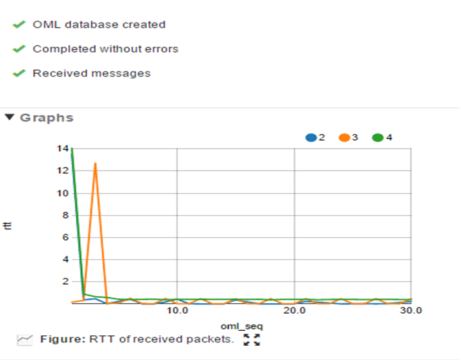
Assignment III - Multi-casting
Teaches the basics of multicasting
Out-of-band signal - used to send “Join” and “Leave” messages to an OpenFlow controller
Functionality of the controller is verified through a layer 2 ping
Lessons learned: multi-casting protocol, packet duplication, layer-2 ping application

Slide 38
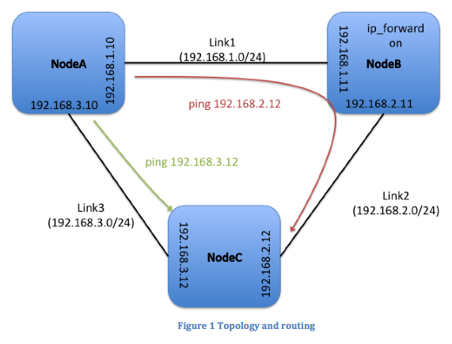
Assignment IV – IP Routing
Teaches the very basics of IP routing
Use ping to verify routing
Can be easily extended:
Geographically distributed topology
Build routing mechanisms on top
Lessons learned: static IP routing, forwarding, impact of route on RTT

Slide 39
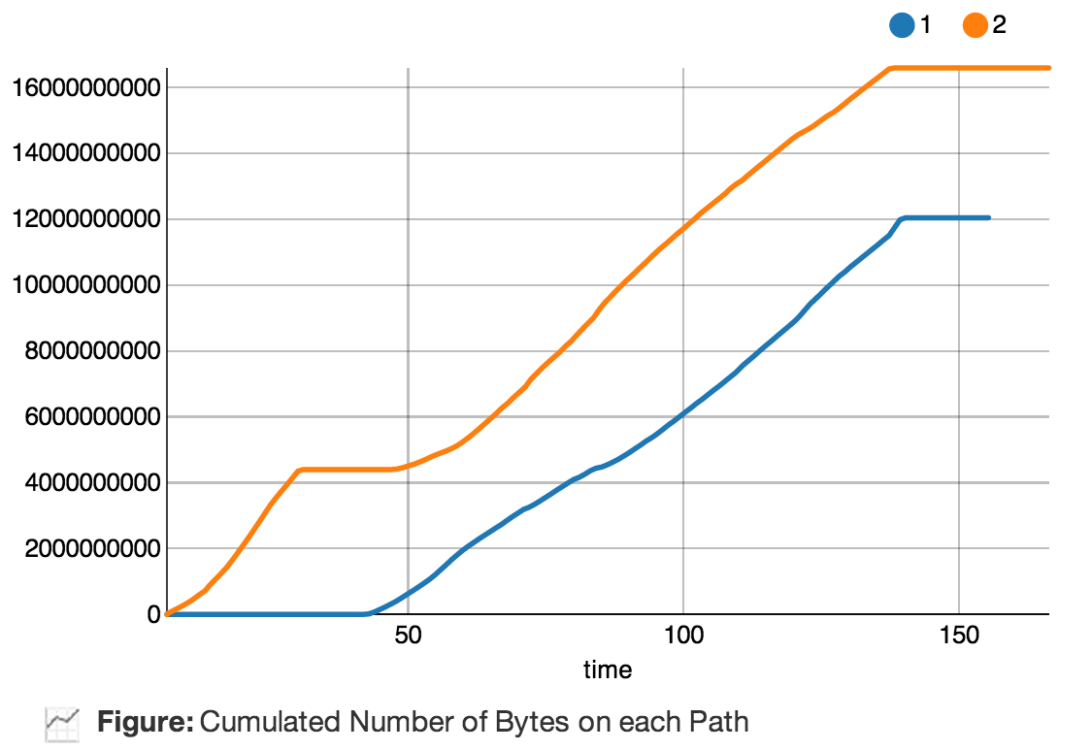
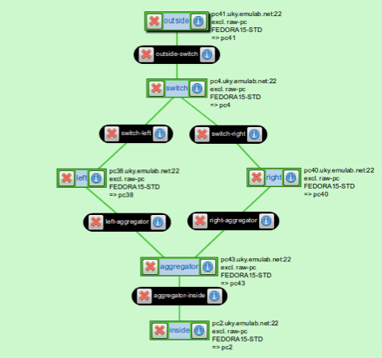
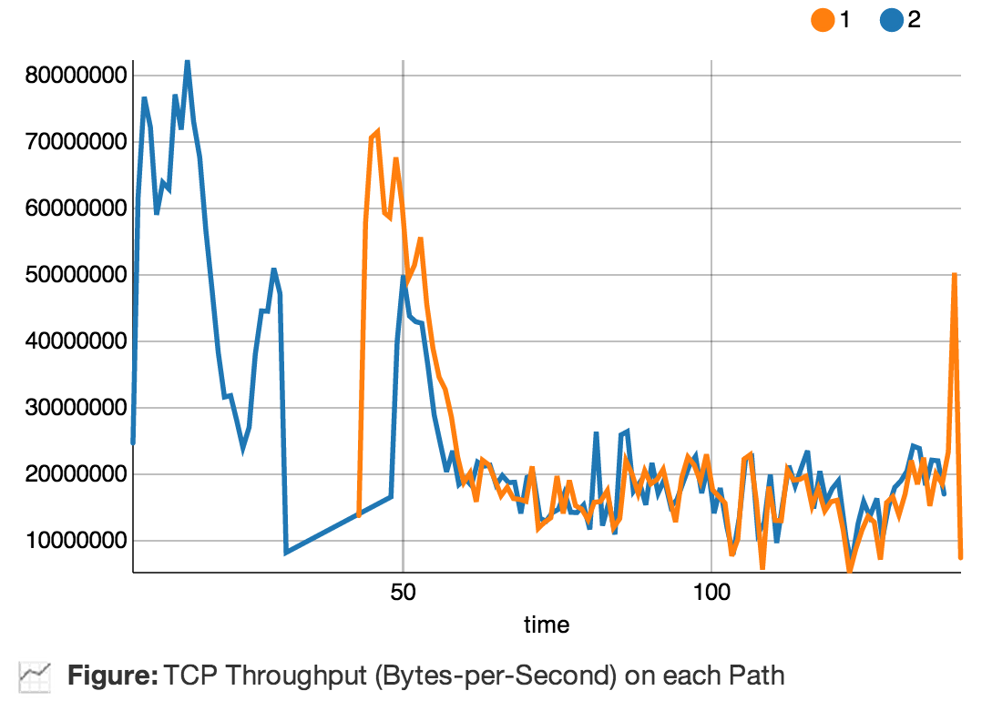
Assignment V – OF Load Balancer
Teaches programming of OpenFlow controller
No OpenFlow knowledge required
Lessons learned: IP routing and forwarding
Total Traffic
Throughput

Slide 40
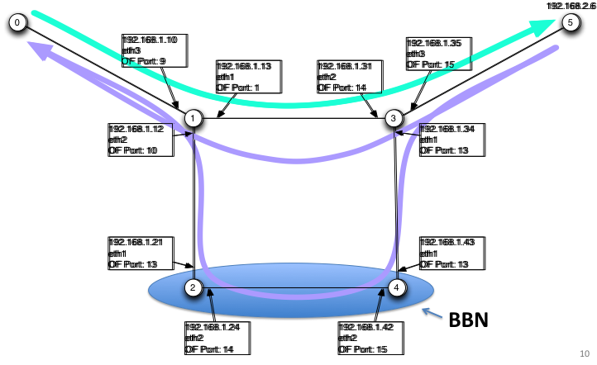
Assignment VI – DASH Video
Teaches how to measure video quality
Uses alternative paths to show impact of RTT on video quality
Lessons learned: OpenFlow basics, DASH basics, network measurement
ExoGENI

Slide 41
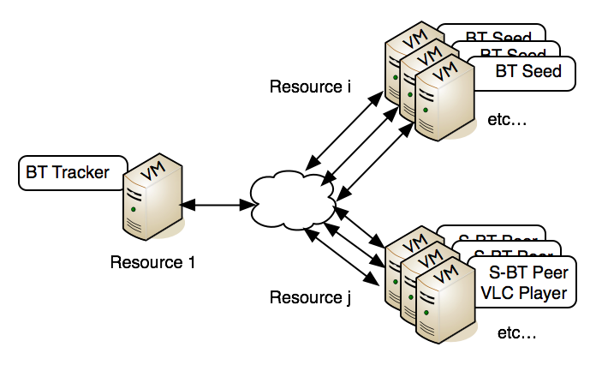
Large-scale Experiments
http://groups.geni.net/geni/wiki/GEC18Agenda/LabWikiAndOEDL

Slide 42
Tomorrow’s Agenda 8:30 AM – 10:00 A.M
Part 1
Extended Learning Switch
Larger topology
Easy to Orchestrate
Part 2
Write Flow Statistics Application
View Flow Statistics in LabWiki
Simple Assignments/Extensions

Slide 43
Where can I get help?
How to write OEDL scripts?
https://omf.mytestbed.net/projects/omf6/wiki/OEDLOMF6
My experiment does not work
Check logs in Execute panel
Contact: geni-users@googlegroups.com
Code
https://github.com/mytestbed/labwiki
Bug Reports and Documentation
http://omf.mytestbed.net/projects/labwiki
Sample custom OML Applications
http://witestlab.poly.edu/site/page/oml-enabled-applications

