Slide 1

Welcome @ FGRE
July 7th – July 11th
Wifi: WelcomeATiMindS
http://doc.ilabt.iminds.be/fgre

Slide 2
FGRE: FIRE resources
July 7th, Gent
Brecht Vermeulen, iMinds

Slide 3
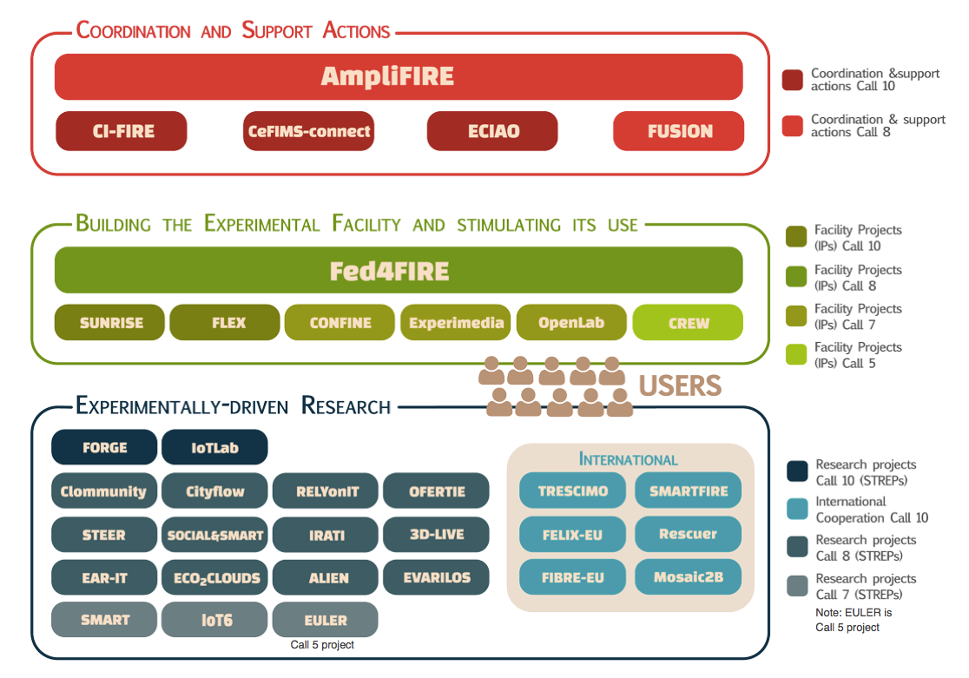
FIRE & Fed4FIRE
Source figure: FIRE Brochure 2014 (AmpliFIRE)

Slide 4




























Fed4FIRE – general info
IP project coordinated by iMinds
10/2012 - 9/2016
Total budget: 7.75 MEUR
28 partners

Slide 5







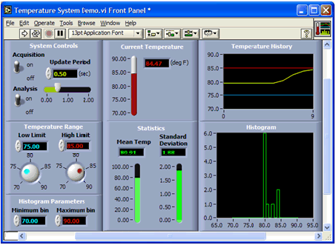




Basic Approach
Architecture
(WP2)
Experimenters
(WP10)
Common Federation Tools
(WP5-6-7-8)
Facilities / Testbeds (WP3-4)

Slide 6
Timing (project start: 1 Oct 2012)
 | Step | DEVELOPMENT CYCLES | WP | Month |  |  |  |  |  |  |  |  |  |  |  |  |  |  |  |  |  |  |  |  |  |  |  |  |  |  |  |  |  |  |  |  |  |  |  | Sustainable mode
 |  |  |  | 1 | 2 | 3 | 4 | 5 | 6 | 7 | 8 | 9 | 10 | 11 | 12 | 13 | 14 | 15 | 16 | 17 | 18 | 19 | 20 | 21 | 22 | 23 | 24 | 25 | 26 | 27 | 28 | 29 | 30 | 31 | 32 | 33 | 34 | 35 | 36 | 37 | 38 | 39 | 40 | 41 | 42 | 43 | 44 | 45 | 46 | 47 | 48
 | 1 | Requirements gathering | WP3-4-8
 | 2 | Architecture and Release Plan | WP2
 | 3 | Detailed specifications | WP5-6-7
 | 4 | Implementation and alfa-testing | WP3-7
 | 5 | Beta- and interoperability testing | WP3-7
 | 6 | Deployment on facilities | WP3-4
 | 7 | Operational with FLS | WP3-4-8
 |  | EXPERIMENT CYCLES
 |  | Call open | WP1
 |  | Negotiation | WP1
 |  | Detailed design | WP10
 |  | Experiment set-up and implementation | WP10
 |  | Experiment execution and validation | WP10
 |  | Final reporting | WP10
 |  | First wave of experimentation facilities
 |  | Second wave of experimentation facilities
 |  |  |  |  |  | CYCLE 1 |  |  |  |  |  |  |  |  |  | CYCLE 2 |  |  |  |  |  |  |  |  |  | CYCLE 3 |  |  |  |  |  |  |  |  |  | SME calls

Slide 7
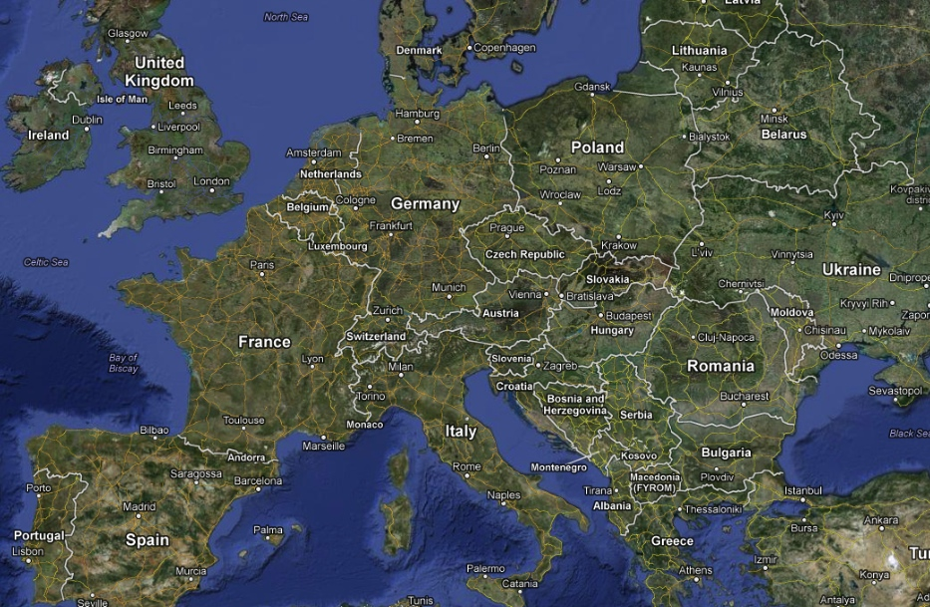
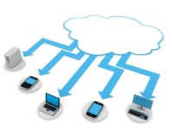
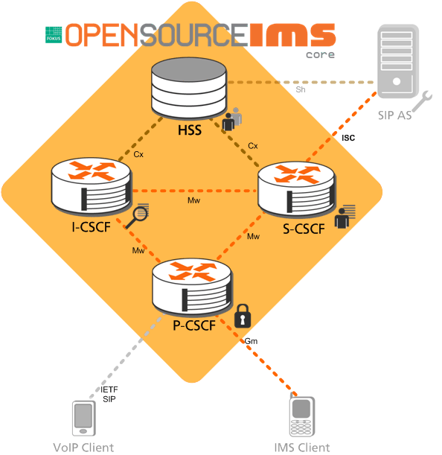



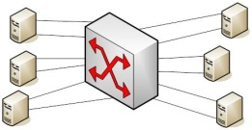



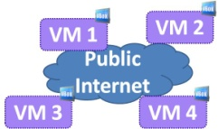
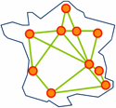
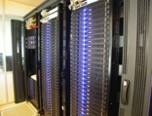



Fed4FIRE facilities
EPCC BonFIRE testbed
Outside EU
Sydney: NORBIT testbed
FuSeCo playground
Korea: KOREN testbed
UNIVBRIS OFELIA island
iLab.t Virtual Wall
Stanford optical access testbed
iLab.t Wireless lab
PlanetLab Europe
Outside EU
Grid’5000
Smart Santander facility
i2CAT OFELIA island
UPC community lab
NITOS wireless testbed
UC3M optical access testbed
UMA LTE performance lab
NETMODE wireless testbed

Slide 8





Experimenter tools
jFed
Significant improvements achieved
  MySlice: overhauled the platform, new plug-ins
  jFed: significant increase in functionality
  NEPI: overhauled platform and increased functionality
  OMF: stability (24/7); vectortypes (spectrum sensing)
  OML: scalability; new transport (AMQP)
Notes:
Myslice, FITeagle, NEPI, OMF, OML, SFA Wrap, geant mdsd,

Slide 9
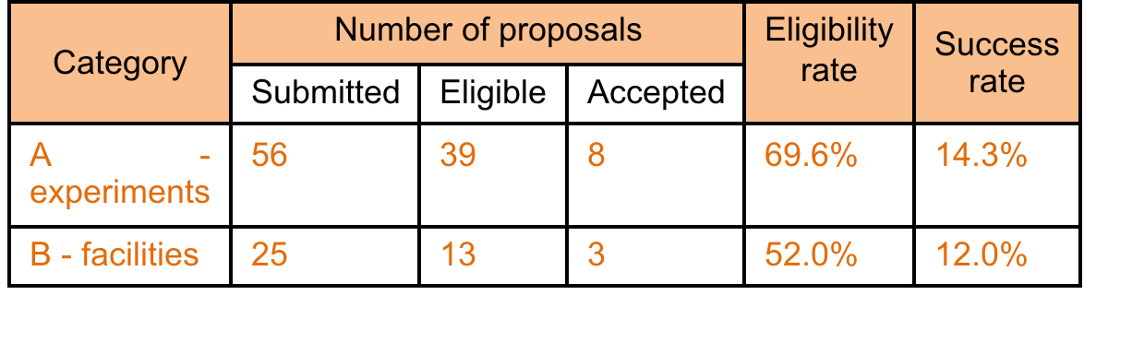
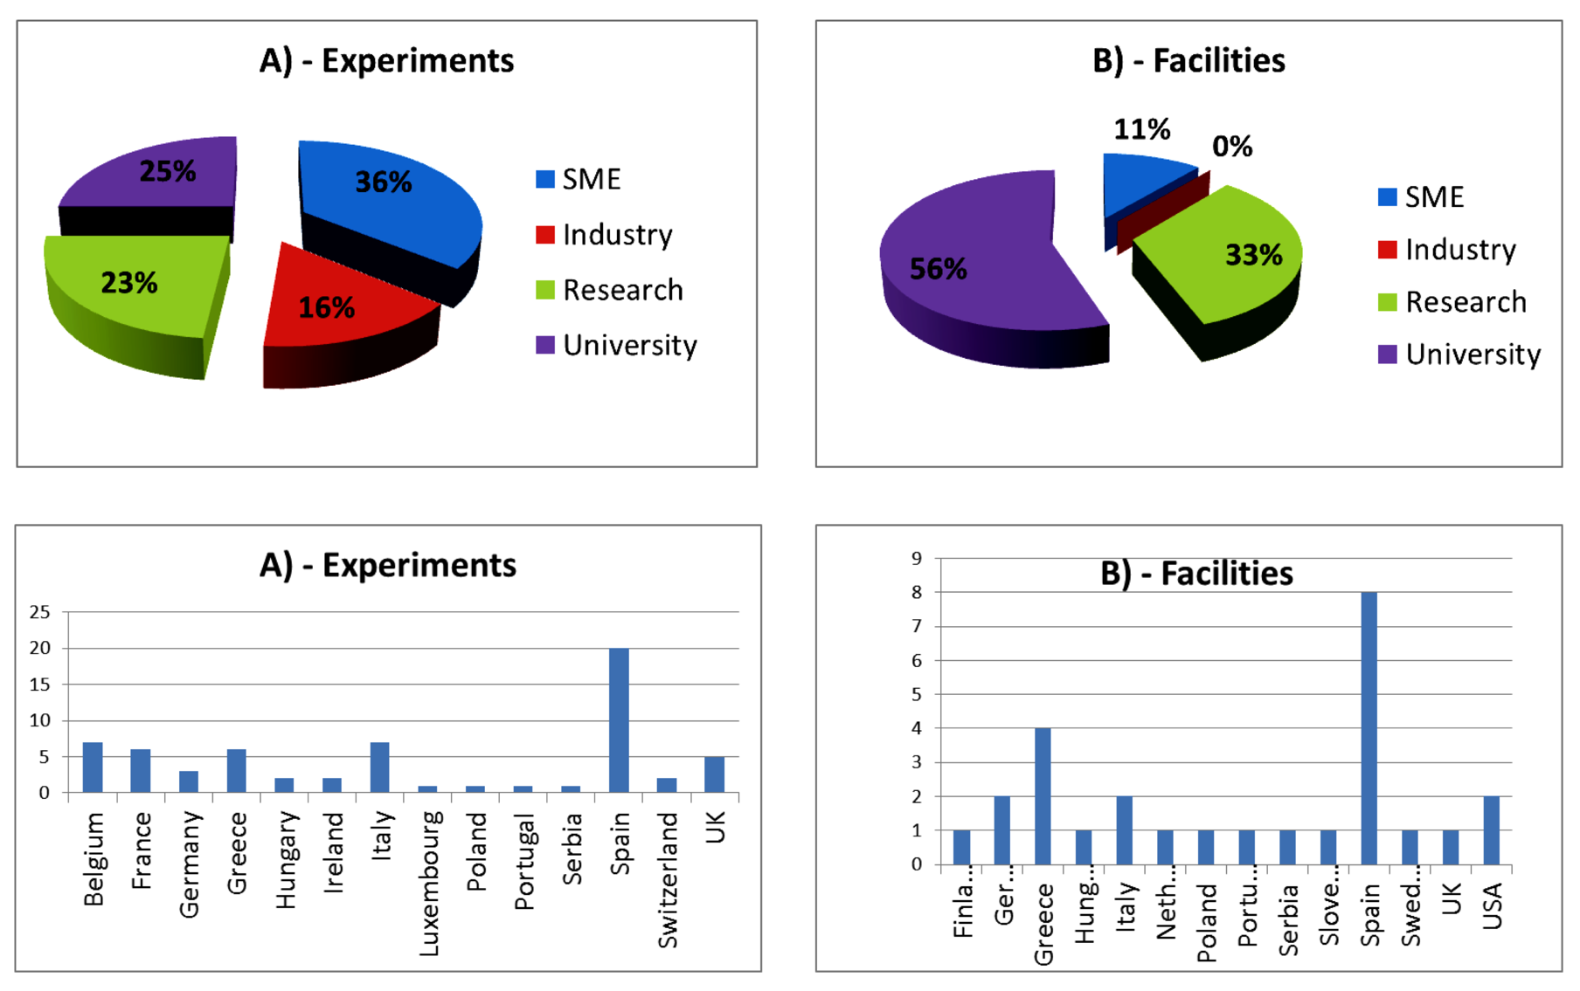
High number of
Open Call 1 submissions

Slide 10
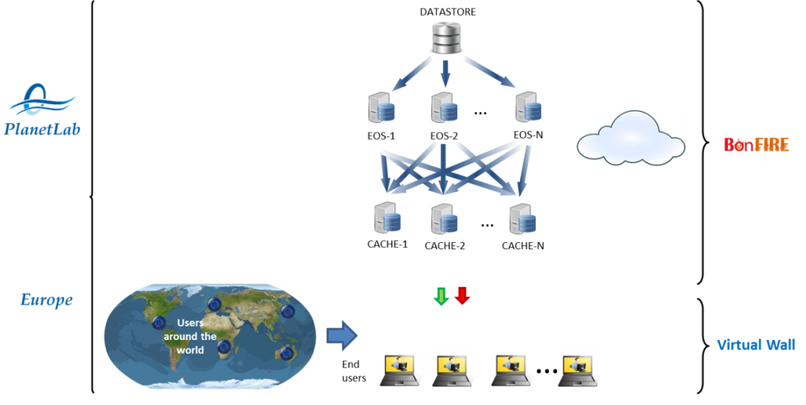
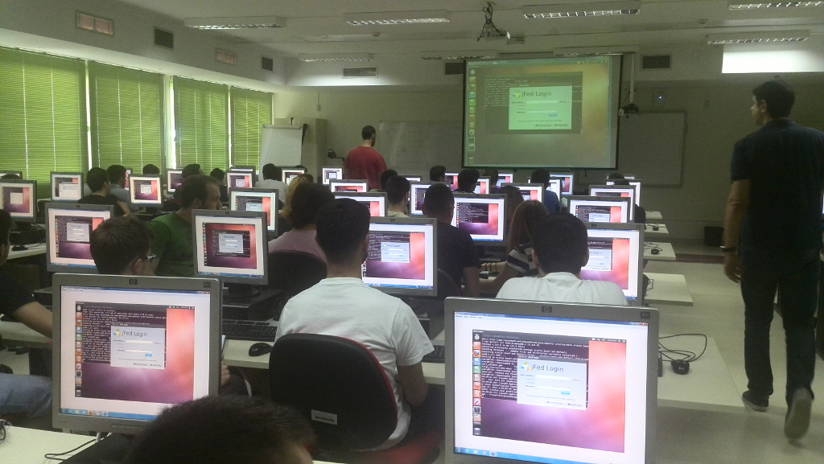
Additional usage of cycle 1 release
Experiments currently going on
  8 from Open Call 1
  4 from SME Open call
Short experiments organized in group context
  Real student labs in context of FORGE (4x50 students)
  SME hands-on session @ Ghent (40 participants)
  Proves production quality!
Noticed that local testbed users here and there are switching from the native testbed interfaces to the Fed4FIRE tools
Geo-Cloud experiment design
FORGE Lab
Notes:
200 Students → very clear illustration of our ambition to deliver a production-quality federation. If you try to give labs with something that doesn’t work well, you’ll know this soon as a professor because of the tons of student complaints ☺. However, after these FORGE labs several students actually mailed us to ask if we could extend their accounts so that they could do some other experiments as well.
Switch of our local users to the Fed4FIRE tools again proves our strive to reach production quality

Slide 11

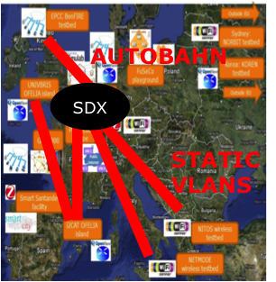
Interconnectivity
Layer 3 interconnectivity:
  Without network translations or SSH proxy
  Stimulating IPv6
Layer 2 – dedicated VLANs
  i2cat, Bristol, iMinds, NITOS, Netmode, Bonfire, US
Layer 2 – dynamic VLANs (Autobahn)
  Recently established: BonFIRE, Virtual Wall
  dynamical setup L2 connections over Géant
  Explore Aggregate Manager prototype that is able to expose Autobahn L2 links as experiment resources through an SFA interface
Notes:
. Some testbeds already support IPv6 access to their resources today: w-iLab.t, Virtual Wall, C-Lab, UltraAccess, PLE (partially) and BonFIRE (partially). Several others are planning to support IPv6 by the end of cycle 2: NITOS, NETMODE, FuSeCo.
--------
Layer 3 interconnectivity: for many applications the only requirement is that all resources should be able to talk to each other without any network translations or SSH proxy. We are therefore stimulating our testbeds to adopt IPv6 (4 testbeds OK, 2 partial OK, 3 by the end of cycle 2)
Layer 2 – dedicated VLANs: we have provided several layer-2 links between specific Fed4FIRE testbeds (i2cat, Bristol, iMinds, NITOS, Netmode, US). These are implemented by the assignment of specific VLANs over Géant. Today 5 such interconnections are in production. Experimenters can reserve such a VLAN for exclusive usage by their experiment using the SFA AM API.
Layer 2 – dynamic VLANs (Autobahn): ideally we could dynamically setup L2 connections over Géant between any 2 testbeds. For this purpose we are exploring the adoption of Autobahn technology. The current test case for Autobahn is the dynamic setup of L2 links between EPCC and iMinds. We are also working on a specific Aggregate Manager prototype that is able to expose Autobahn L2 links as experiment resources through an SFA interface (nearly completed).
----------
Layer 3 interconnectivity: for many applications the only requirement is that all resources should be able to talk to each other without any network translations or SSH proxy. We are therefore stimulating our testbeds to adopt IPv6 (4 testbeds OK, 2 partial OK, 3 by the end of cycle 2)
Layer 2 – dedicated VLANs: we have provided several layer-2 links between specific Fed4FIRE testbeds (i2cat, Bristol, iMinds, NITOS, Netmode, US). These are implemented by the assignment of specific VLANs over Géant. Today 5 such interconnections are in production. Experimenters can reserve such a VLAN for exclusive usage by their experiment using the SFA AM API.
Layer 2 – dynamic VLANs (Autobahn): ideally we could dynamically setup L2 connections over Géant between any 2 testbeds. For this purpose we are exploring the adoption of Autobahn technology. The current test case for Autobahn is the dynamic setup of L2 links between EPCC and iMinds. We are also working on a specific Aggregate Manager prototype that is able to expose Autobahn L2 links as experiment resources through an SFA interface (nearly completed).

Slide 12
Sustainability

Slide 13

Potential business scenarios
Invisible coordination
Matchmaker
One-stop shop
Advisor
Integrator
High
Federator Control
Many
Scenarios based upon the cases presented in
Low
Services offered by Federator
Few

Slide 14




Initial proposed business scenario
One-stop shop
Resource reservation(s)
Experimenters
Authentication
Documentation
First level support
SLA / OLA management
Request resources & services
Invoke services on infrastructure
Federator
Usage
information
Resource
reservation
Facility
providers
Based upon Fed4FIRE cycle 2 architecture for discovery, reservation and provisioning

Slide 15
Monitoring & testing

Slide 16
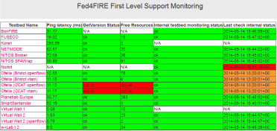




Facility Monitoring
FLS Monitoring Dashboard
SLA mgmt
http://monitor.ilabt.iminds.be
3
RAG Status
OML Server + Database
3
Access data
2
Provide data as OML Streams
Zabbix/
Nagios/etc
1
Fetch data
OML
Testbed

Slide 17
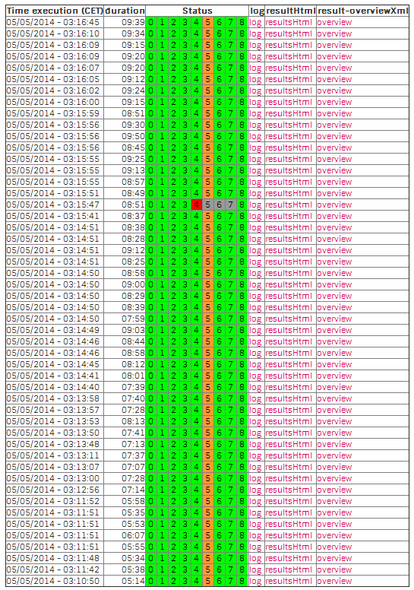
Tutorials/summer schools: stress testing

Slide 18
Some experiments

Slide 19
GEC 20 demo

Slide 20
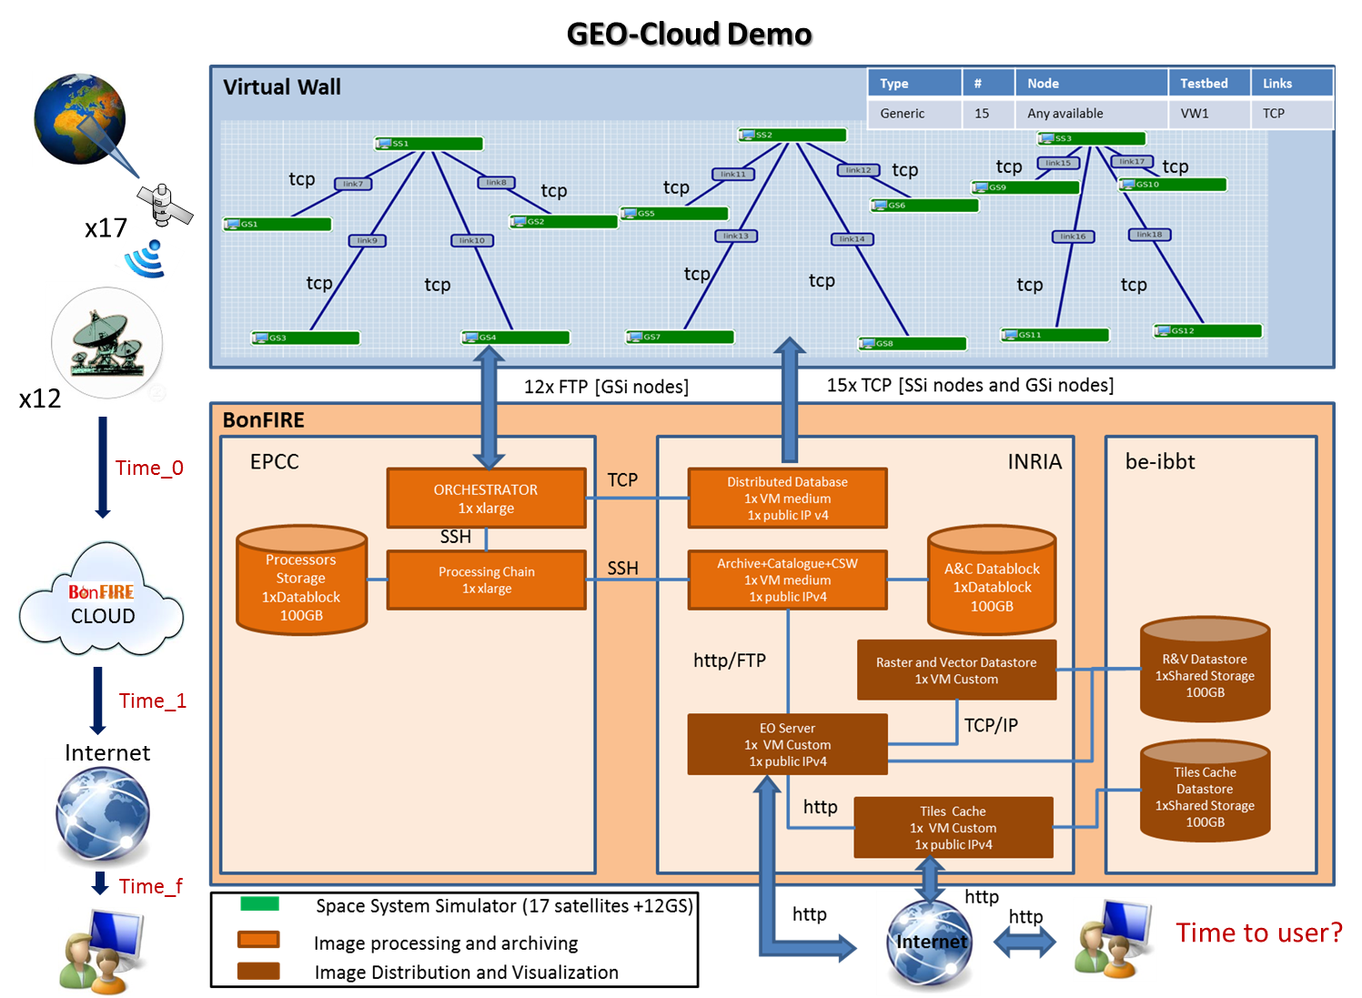
Geo-Cloud
Earth Observation system - from acquisition of geo-data from satellites to its distribution

Slide 21
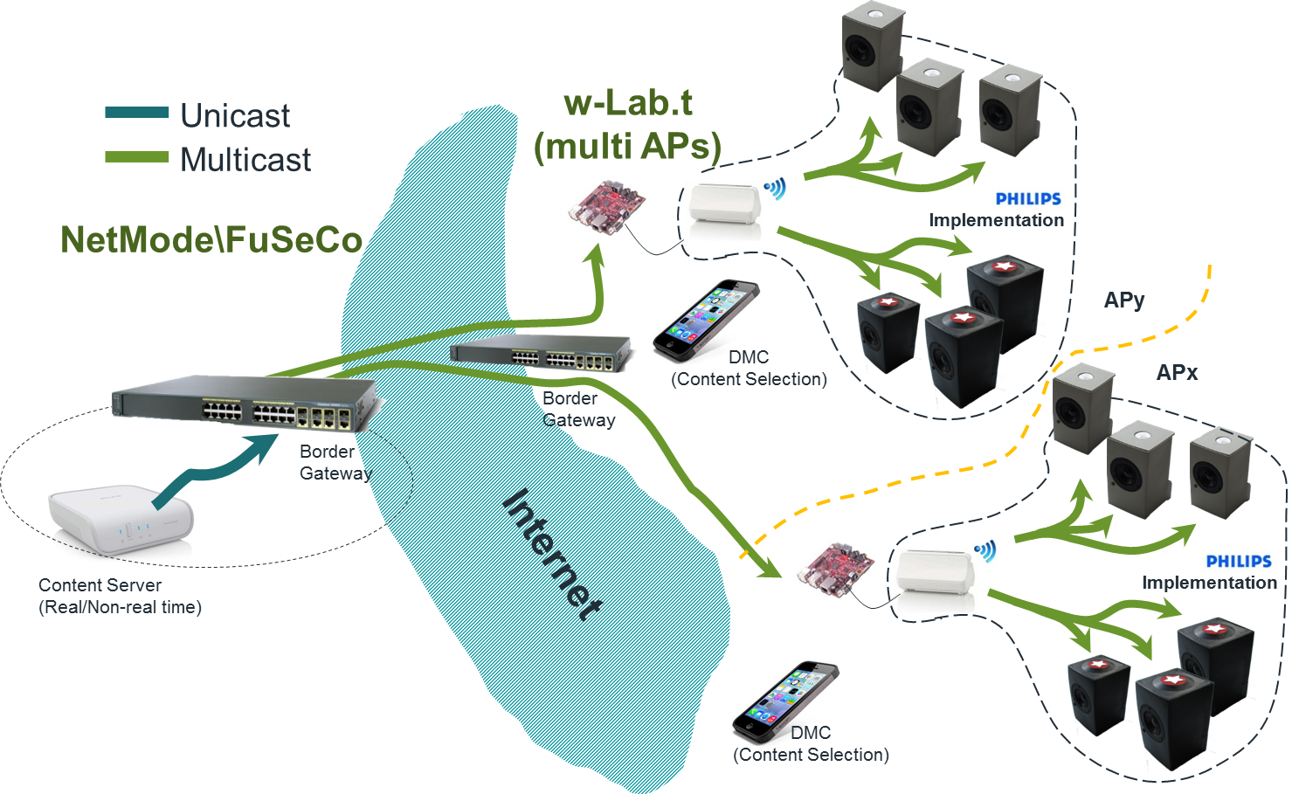
Medianet
Synchronous wireless IP multicasting over PGM (Pragmatic General Multicast

Slide 22
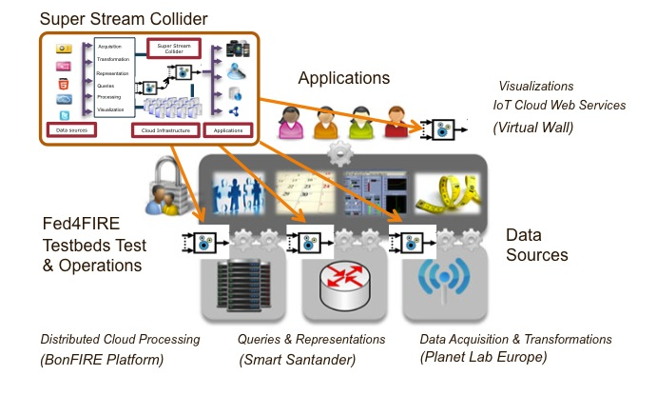
SSC-Fed4FIRE
Service capability to process collected sensor data and to provide data streams in the form of easy-configurable data services

Slide 23
Questions ?

